Slide 1
Blood donation sytem
By Mhmmad Faizan Abid
Hasnat Amir
Muhammad Noman imran

Slide 2
Main idea
Our idea mainly consists on the problem of blood requirement and how its deliverability is done.
We see that we get many emails etc on daily basis about how and where people need certain kind of blood.
From these messages we concluded that there is a need for the Blood donating system.

Slide 3
Motivation
To help the community in finding an easier and more reliable source of info about blood availability.
To make it easy for both volunteer and the person in need.

Slide 4
Problem statement
No such system exist in our city, which provides information related to instant blood requirements and deleiverance

Slide 5
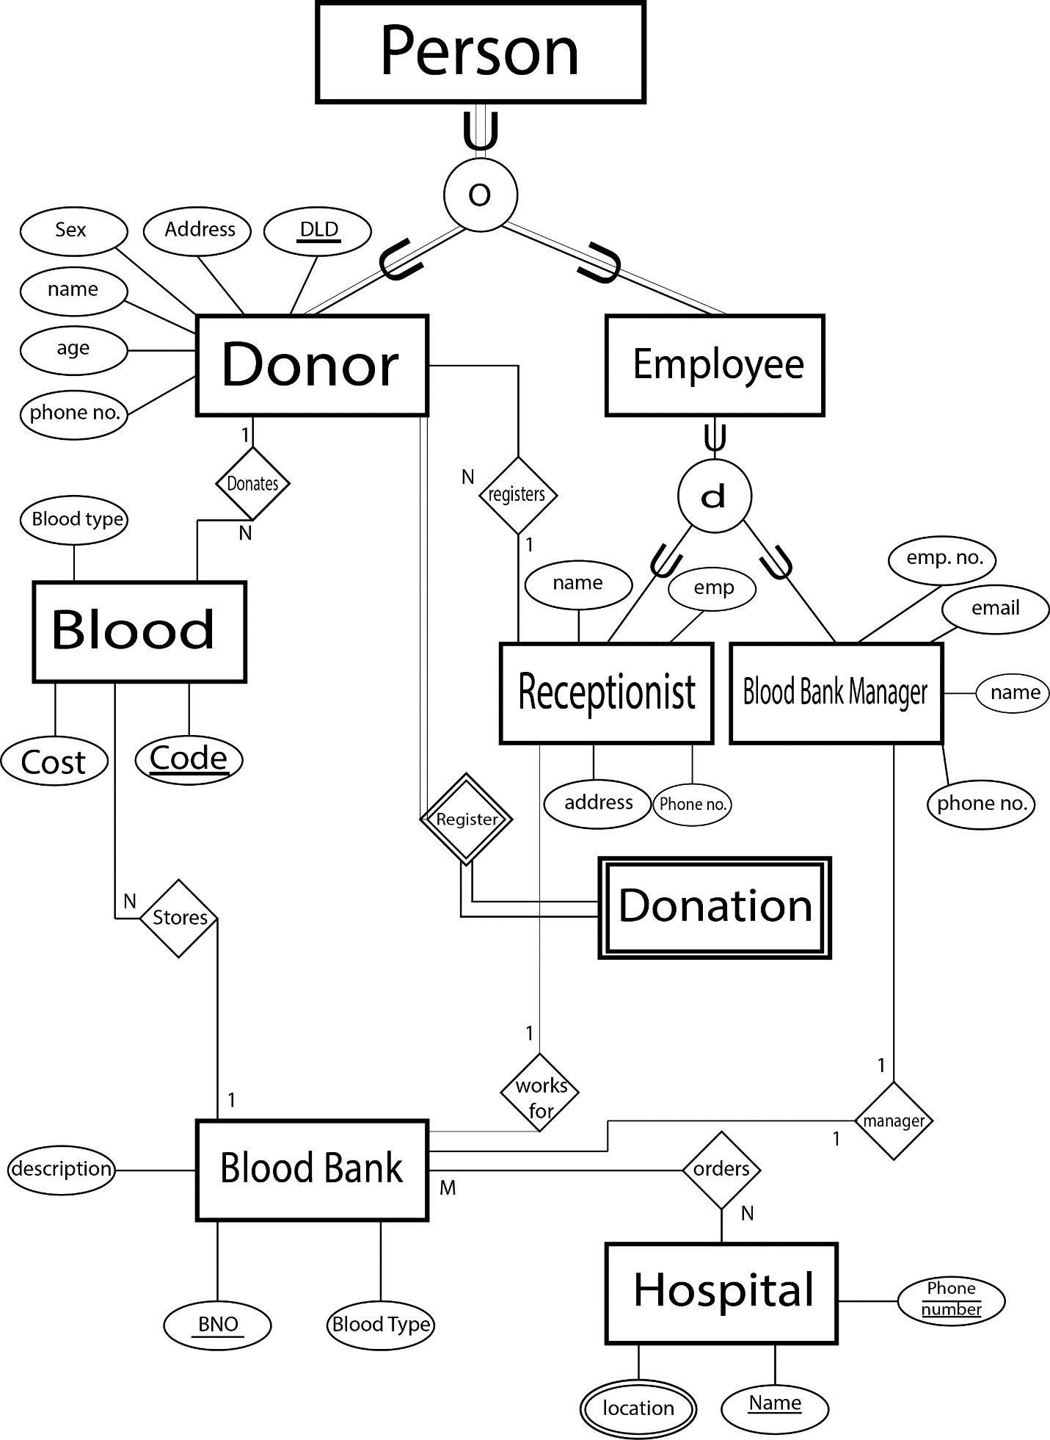
ERD explanation

Slide 6
Solution
Using the concepts of data handling and database management we created a system to provide both donor and receiver the RIGHT information to provide an ease to both

Slide 7
Conclusion
How it will help the user?
By using this system, patient can get blood on urgent bases within time and with minimal effort
The donor also get the work done with by knowing where the blood is required and what amount is required

